Slide 1
Feature Selection in Machine Learning
for BioMedical Data
Nov 07 2025
Giảng viên: TS. Lưu Phúc Lợi
Email: Luu.p.loi@googlemail.com
Zalo: 0901802182

Slide 2
Content
Introduction to Feature Selection
Filter method
Wrapper methods
Embedded method
Hydrid method

Slide 3
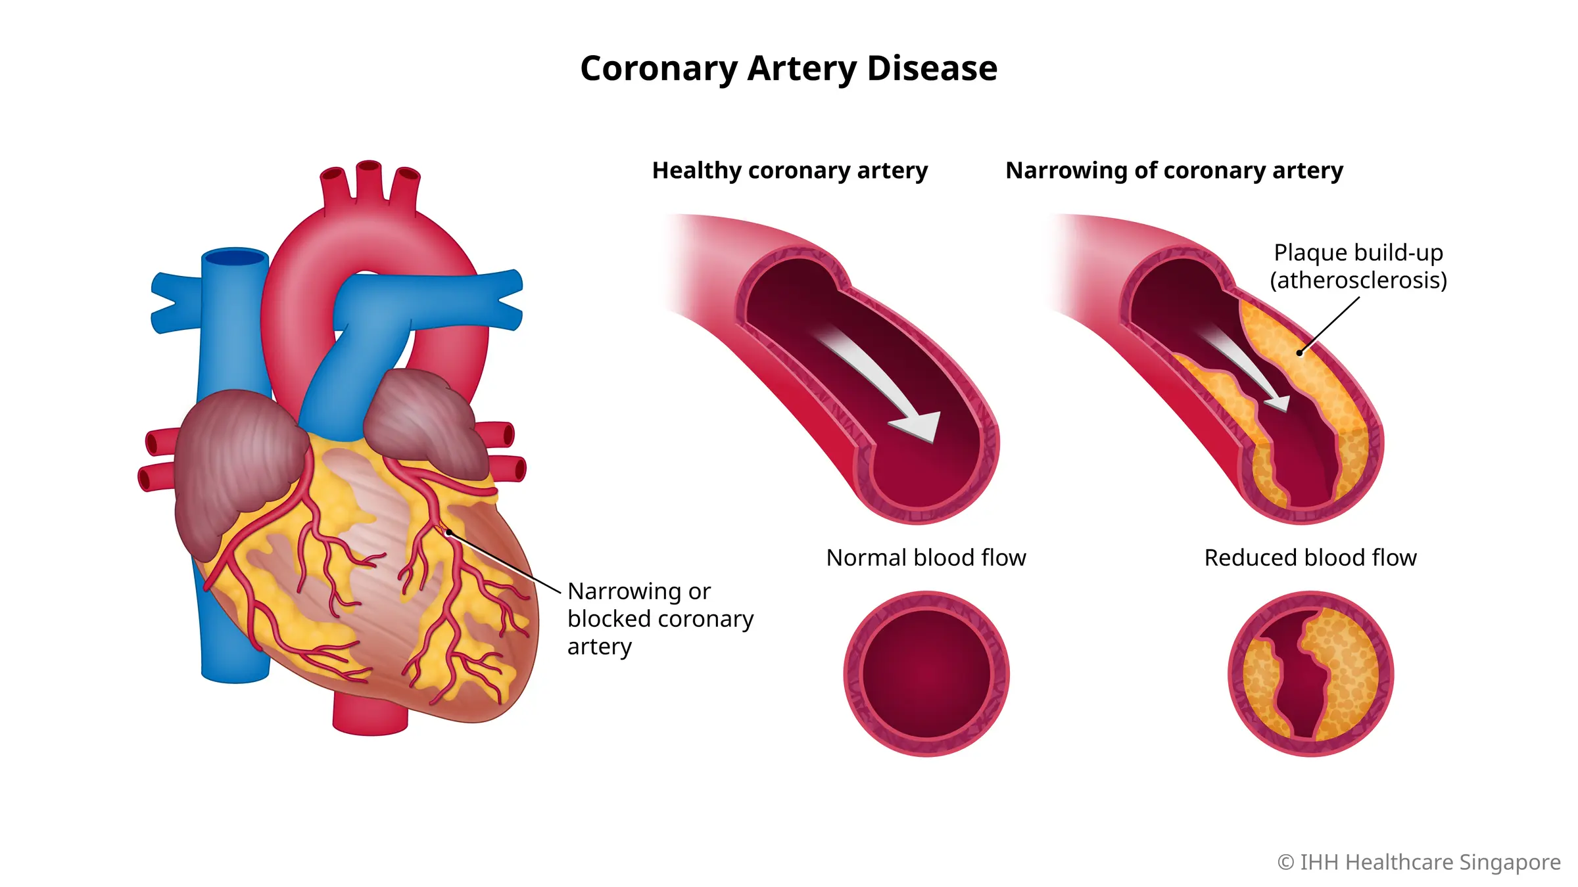

Slide 4
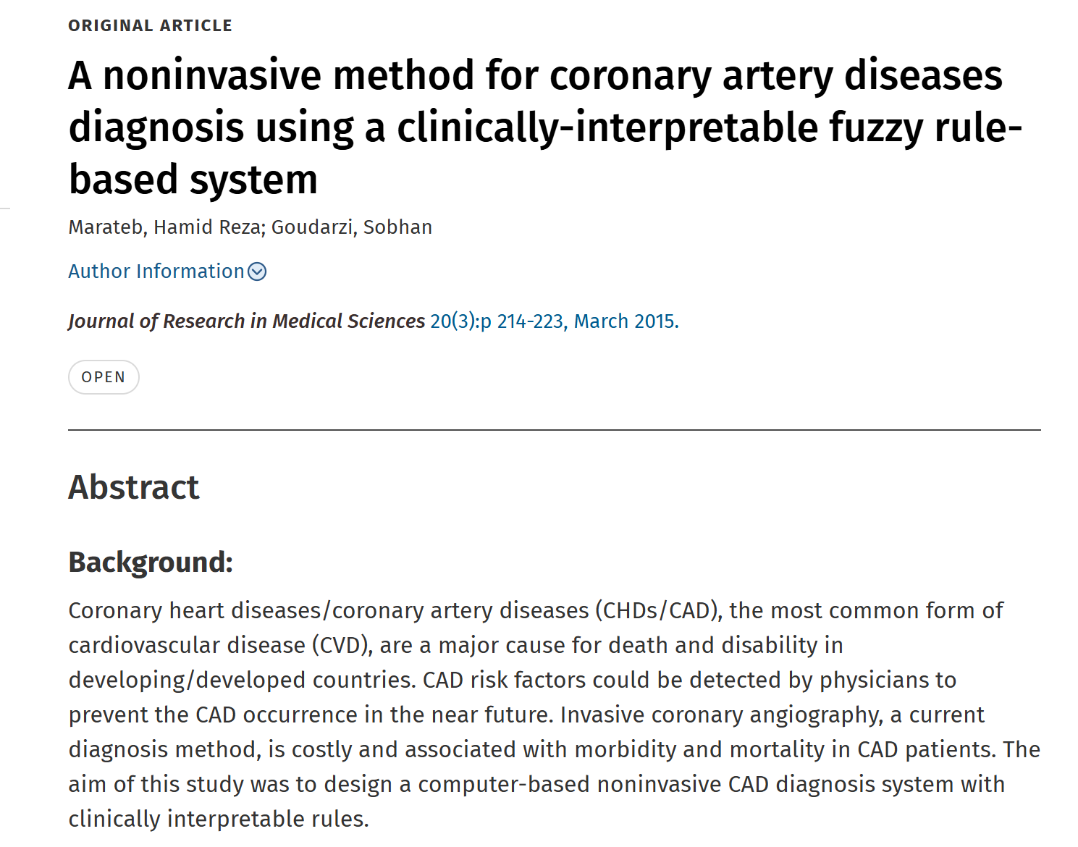
https://journals.lww.com/jrms/fulltext/2015/20030/a_noninvasive_method_for_coronary_artery_diseases.2.aspx

Slide 5
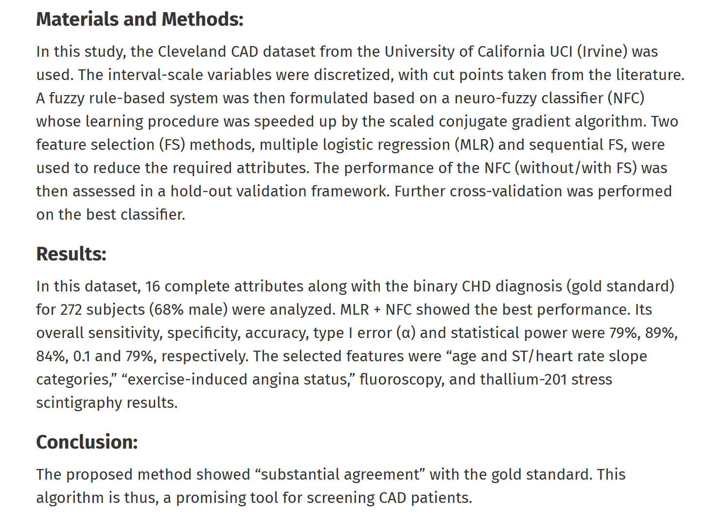

Slide 6
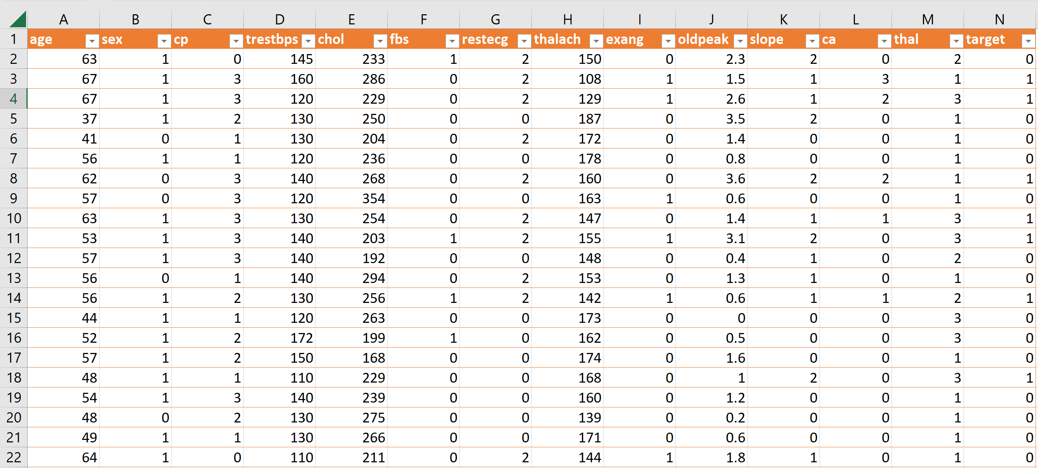
Problem statement
Predicting Heart Disease from the Cleveland Heart Disease Dataset (303 samples x 76 features)
https://www.kaggle.com/datasets/ritwikb3/heart-disease-cleveland

Slide 7
Predicting Heart Disease from the Cleveland Heart Disease Dataset
(303 samples x 13 features)
https://www.kaggle.com/datasets/ritwikb3/heart-disease-cleveland

Slide 8
Cleveland Heart Disease Dataset
This database contains 13 attributes and a target variable. It has 8 nominal values and 5 numeric values. The detailed description of all these features are as follows:
Age: Patients Age in years (Numeric)
Sex: Gender (Male : 1; Female : 0) (Nominal)
cp: Type of chest pain experienced by patient. This term categorized into 4 category. 0 typical angina, 1 atypical angina, 2 non- anginal pain, 3 asymptomatic (Nominal)
trestbps: patient's level of blood pressure at resting mode in mm/HG (Numerical)
chol: Serum cholesterol in mg/dl (Numeric)
fbs: Blood sugar levels on fasting > 120 mg/dl represents as 1 in case of true and 0 as false (Nominal)
restecg: Result of electrocardiogram while at rest are represented in 3 distinct values 0 : Normal 1: having ST-T wave abnormality (T wave inversions and/or ST elevation or depression of > 0.05 mV) 2: showing probable or definite left ventricular hypertrophyby Estes' criteria (Nominal)
thalach: Maximum heart rate achieved (Numeric)

Slide 9
Cleveland Heart Disease Dataset
This database contains 13 attributes and a target variable. It has 8 nominal values and 5 numeric values. The detailed description of all these features are as follows:
9. exang: Angina induced by exercise 0 depicting NO 1 depicting Yes (Nominal)
10. oldpeak: Exercise induced ST-depression in relative with the state of rest (Numeric)
11. slope: ST segment measured in terms of slope during peak exercise
0: up sloping; 1: flat; 2: down sloping(Nominal)
12. ca: The number of major vessels (0–3)(nominal)
13. thal: A blood disorder called thalassemia
0: NULL 1: normal blood flow 2: fixed defect (no blood flow in some part of the heart) 3: reversible defect (a blood flow is observed but it is not normal(nominal)
14. target: It is the target variable which we have to predict 1 means patient is suffering from heart disease and 0 means patient is normal.
Variable to be predicted
Absence (1) or presence (2) of heart disease

Slide 10
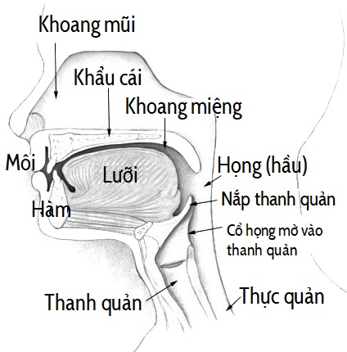
Oral Cavity and Pharyngeal Cancer
https://vi.wikipedia.org/wiki/C%E1%BB%95_h%E1%BB%8Dng#/media/T%E1%BA%ADp_tin:Illu01_head_neck_vi.jpg

Slide 11
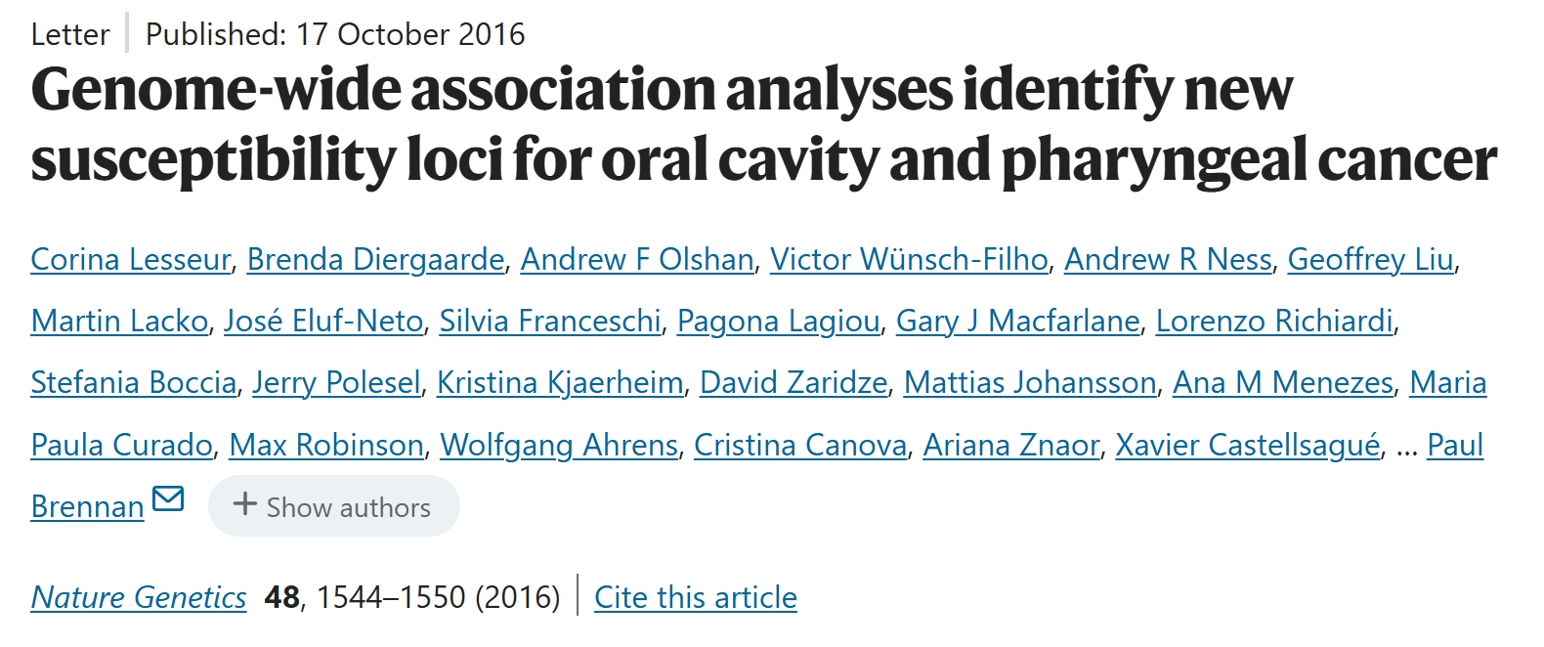
https://www.nature.com/articles/ng.3685

Slide 12
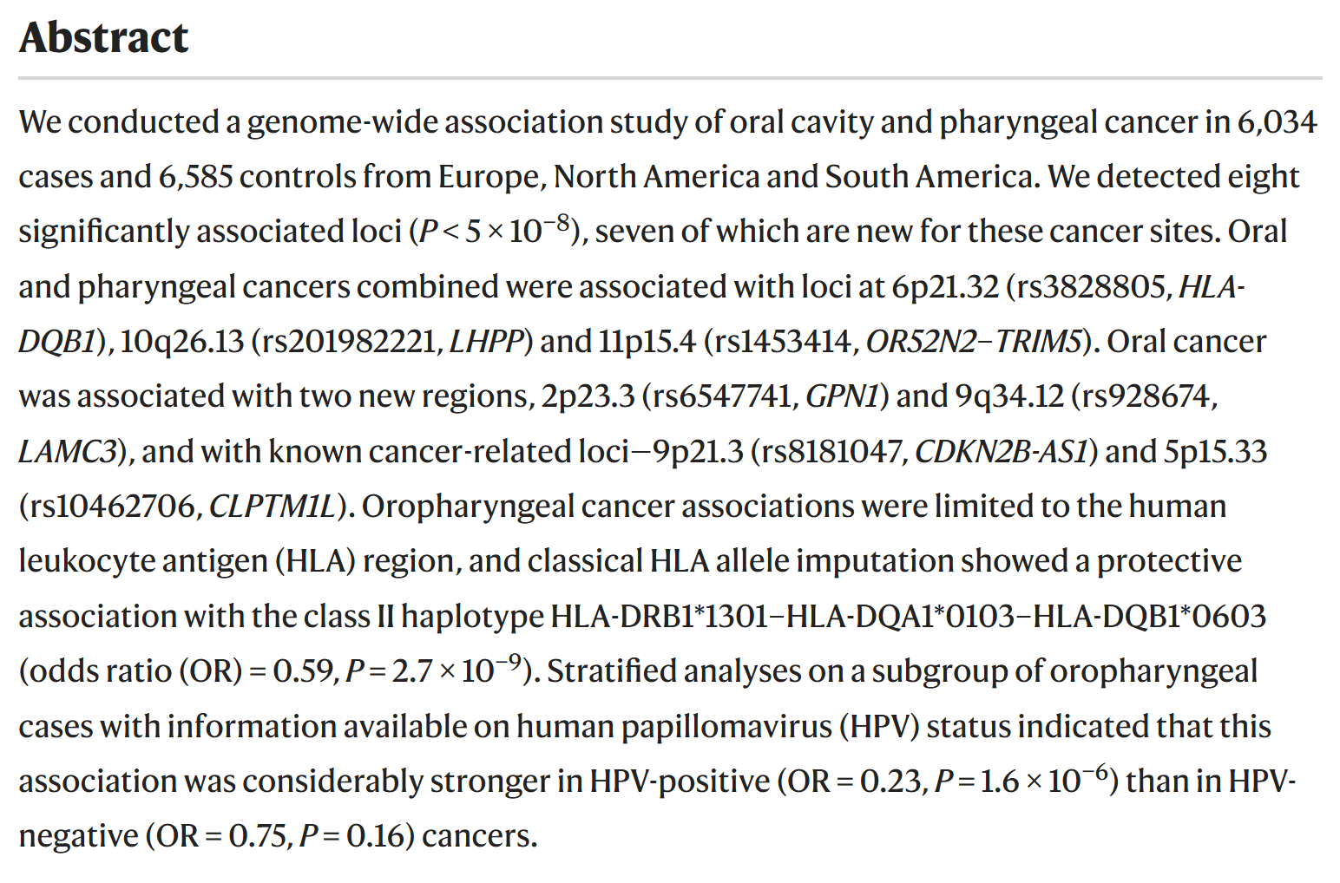
https://www.nature.com/articles/ng.3685

Slide 13
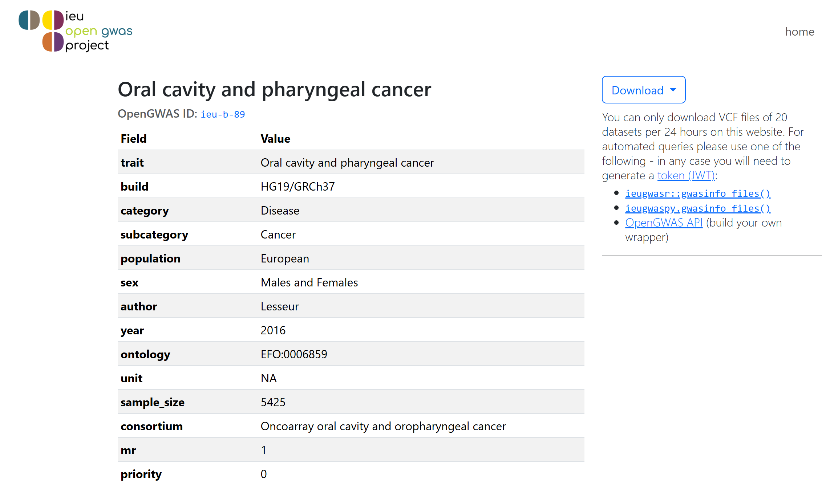
https://opengwas.io/datasets/ieu-b-89

Slide 14
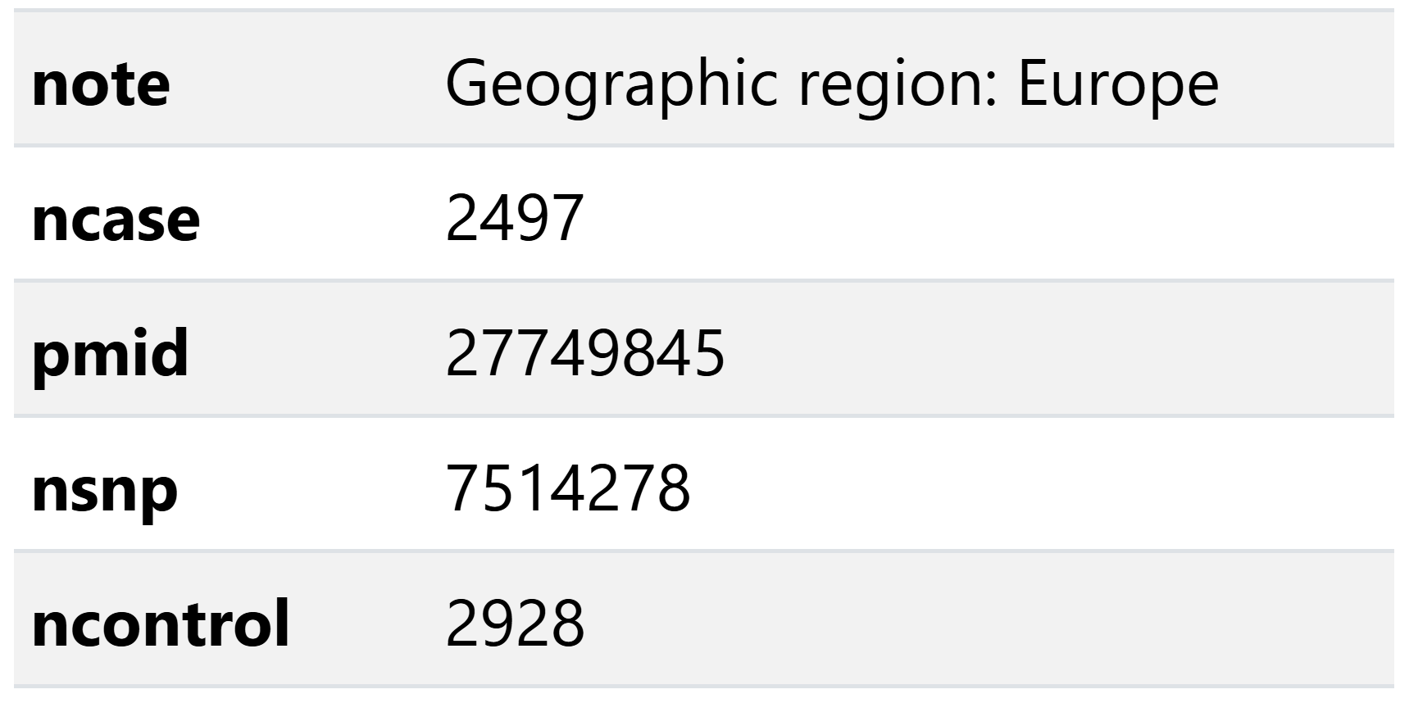
SNP - Oral Cavity and Pharyngeal Cancer Dataset
https://opengwas.io/datasets/ieu-b-89

Slide 15
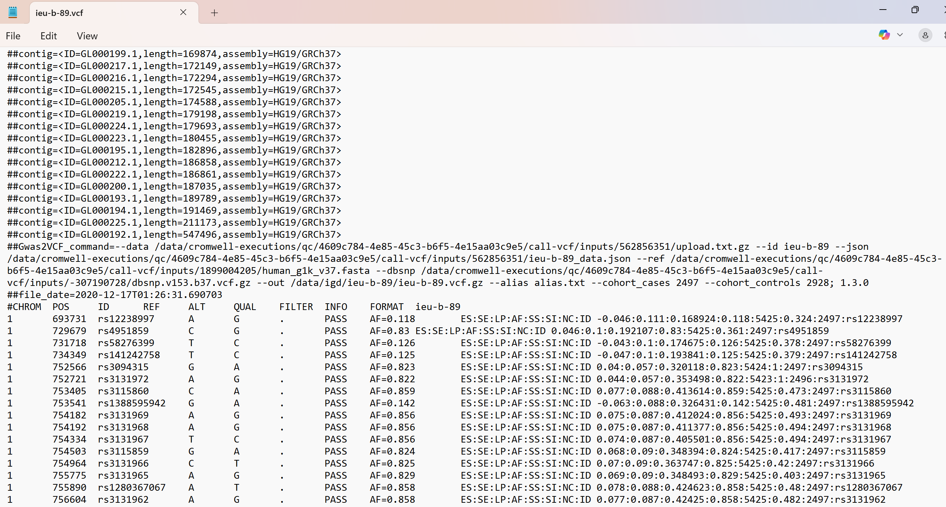
SNP - Oral Cavity and Pharyngeal Cancer Dataset
https://opengwas.io/datasets/ieu-b-89#

Slide 16
Introduction to Feature Selection

Slide 17
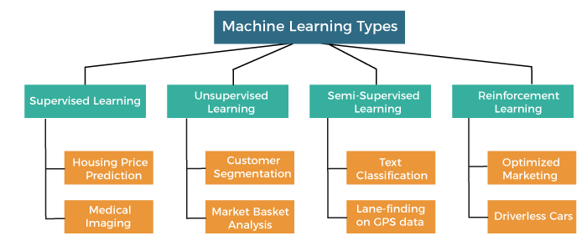

Slide 18
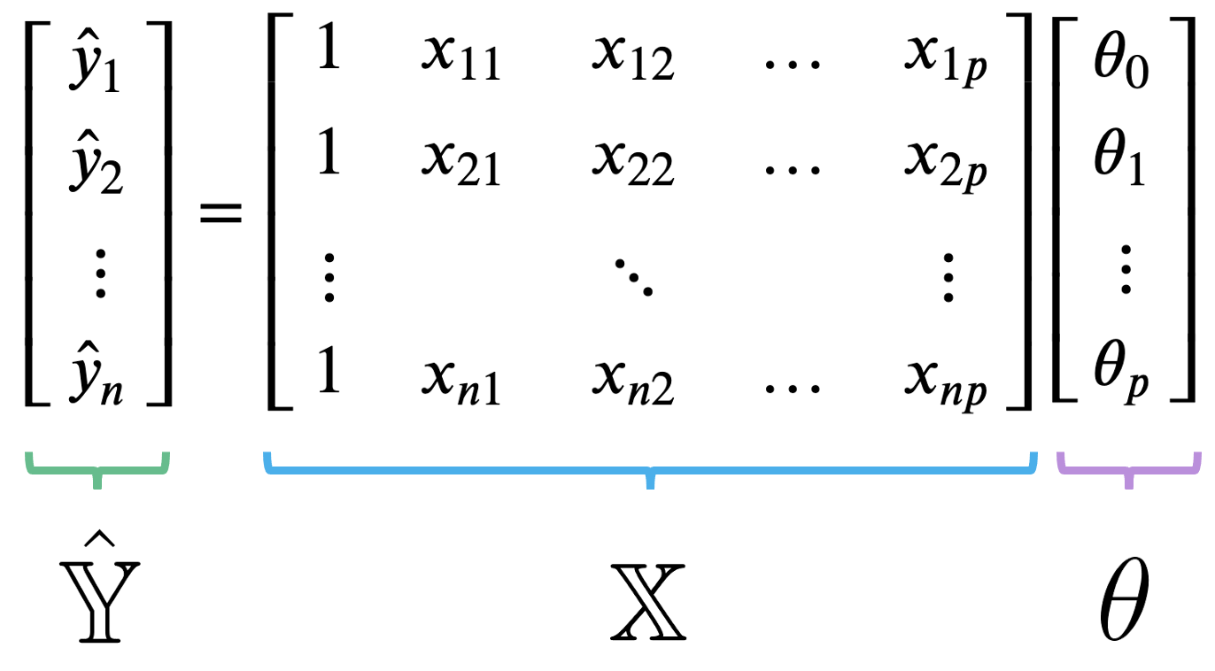
Supervise Learning: regression or classification

Slide 19
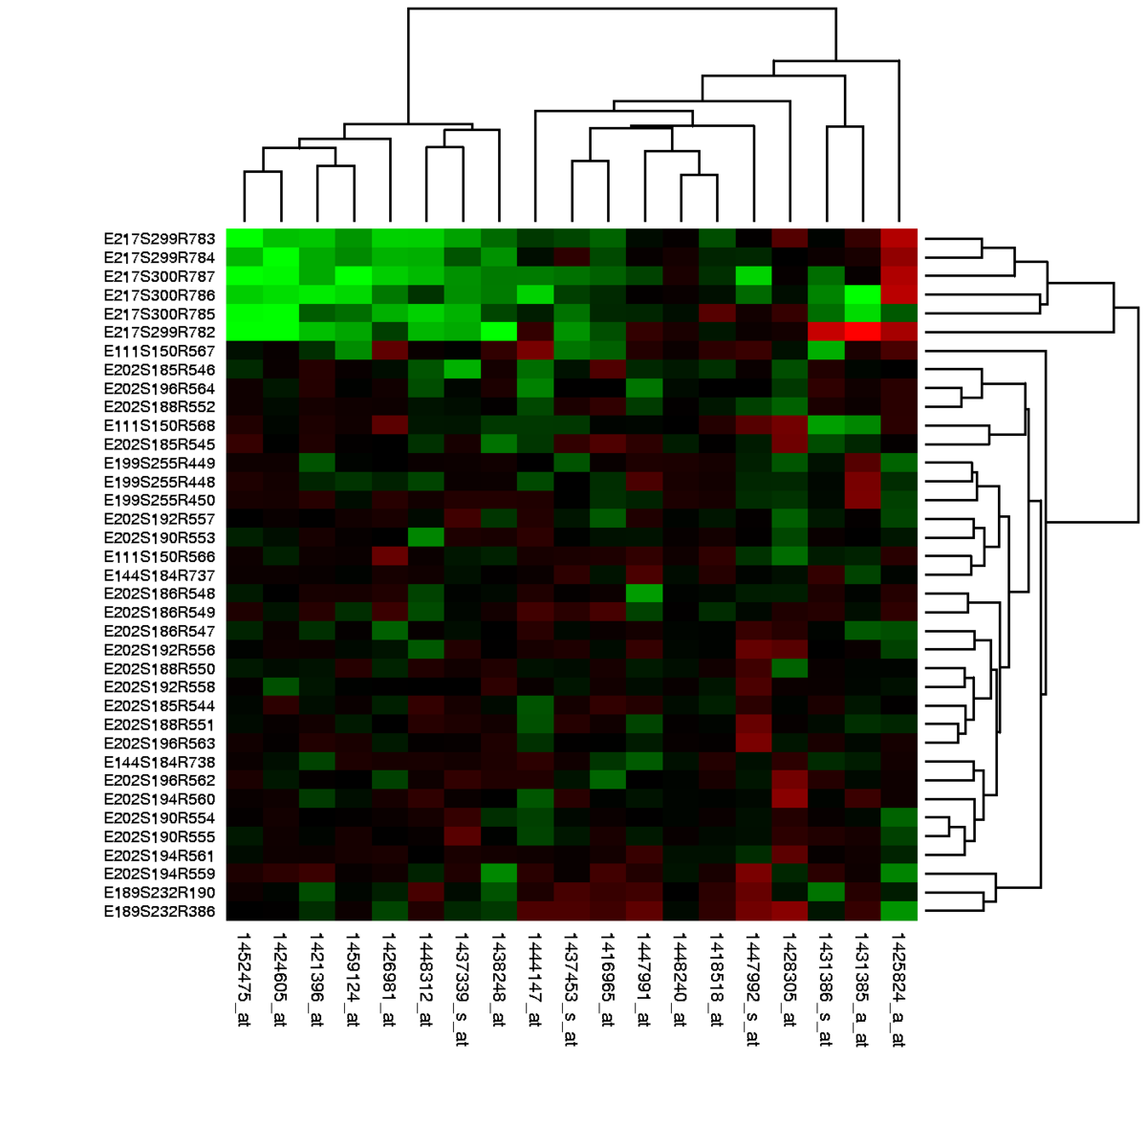
BioMedical data: gene expression with p >> n
n = number of samples 6, 10, 100, 1k
P = number of genes 20k
https://en.wikipedia.org/wiki/Gene_expression_profiling

Slide 20
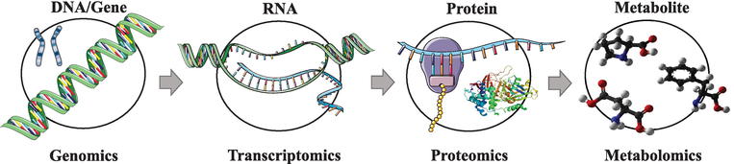
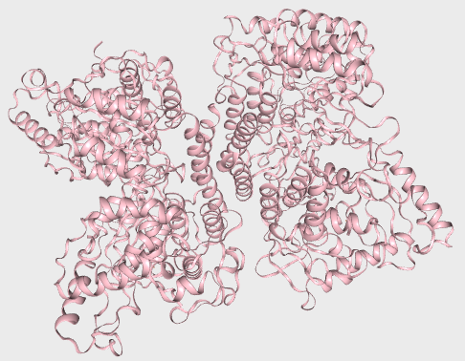
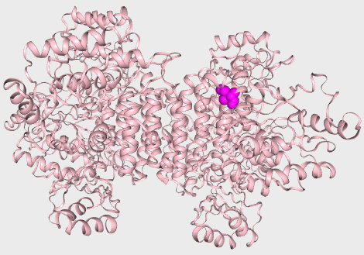
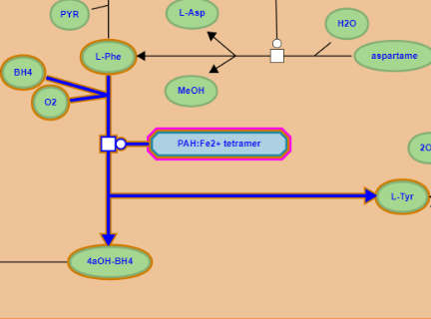
Mối liên kết: Biến thể gen và bệnh di truyền
PAH gene
Ref …ATCGAT…
P1 …AACGAT…
NM_000277.3(PAH):c.971T>A
PAH mRNA
Ref …AUCGAU…
P1 …AACGAU…
NM_000277.3(PAH):c.971T>A
PAH protein
Ref …Ile-Asp…
P1 …Asn-Asp…
NM_000277.3(PAH):p.Ile324Asn
PAH
Ref Phe → Tyr
PAH
P1 Phe → Tyr
10.5772/intechopen.71769

Slide 21
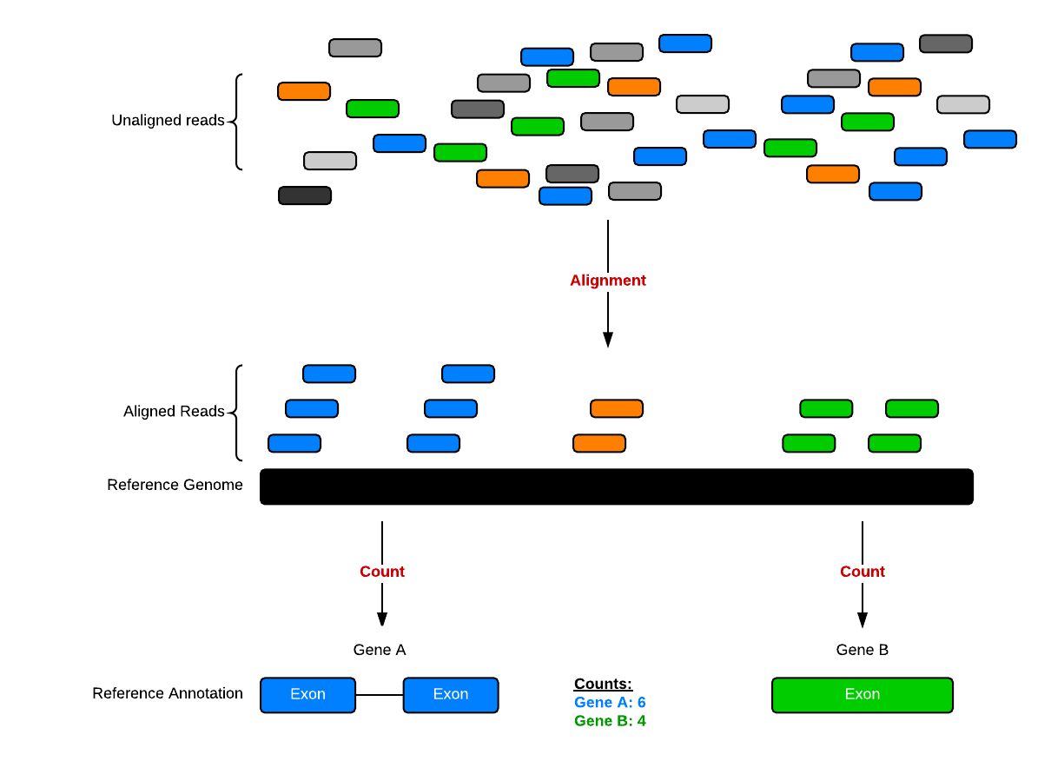
How to generate genomic data: RNA-seq

Slide 22
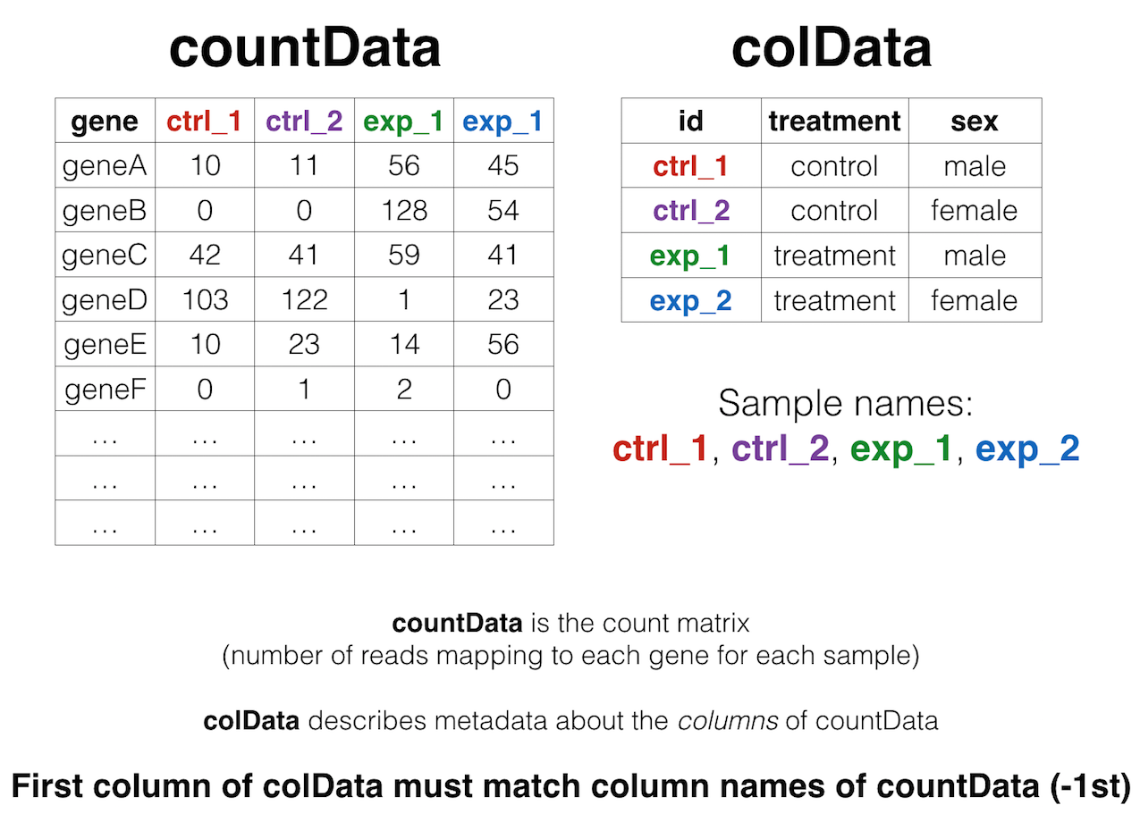
RNA-seq count table
https://bioconnector.github.io/workshops/r-rnaseq-airway.html

Slide 23
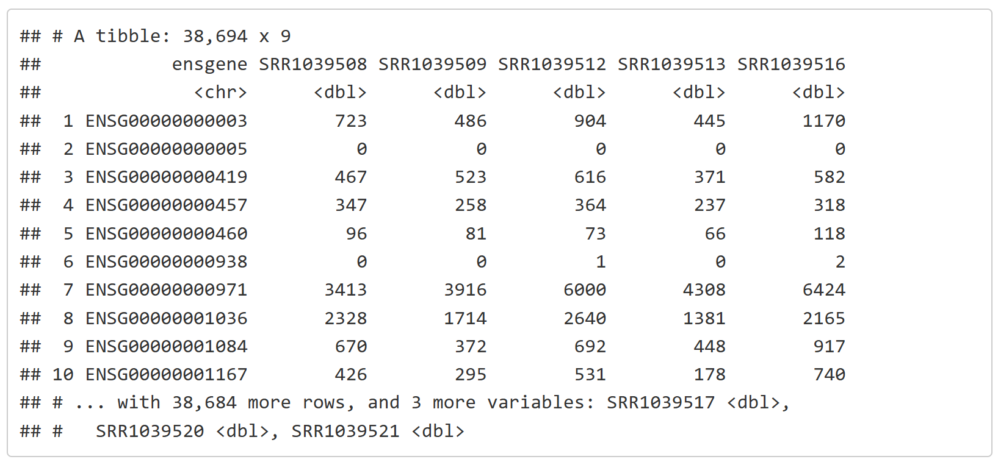
RNA-seq count table
https://bioconnector.github.io/workshops/r-rnaseq-airway.html

Slide 24
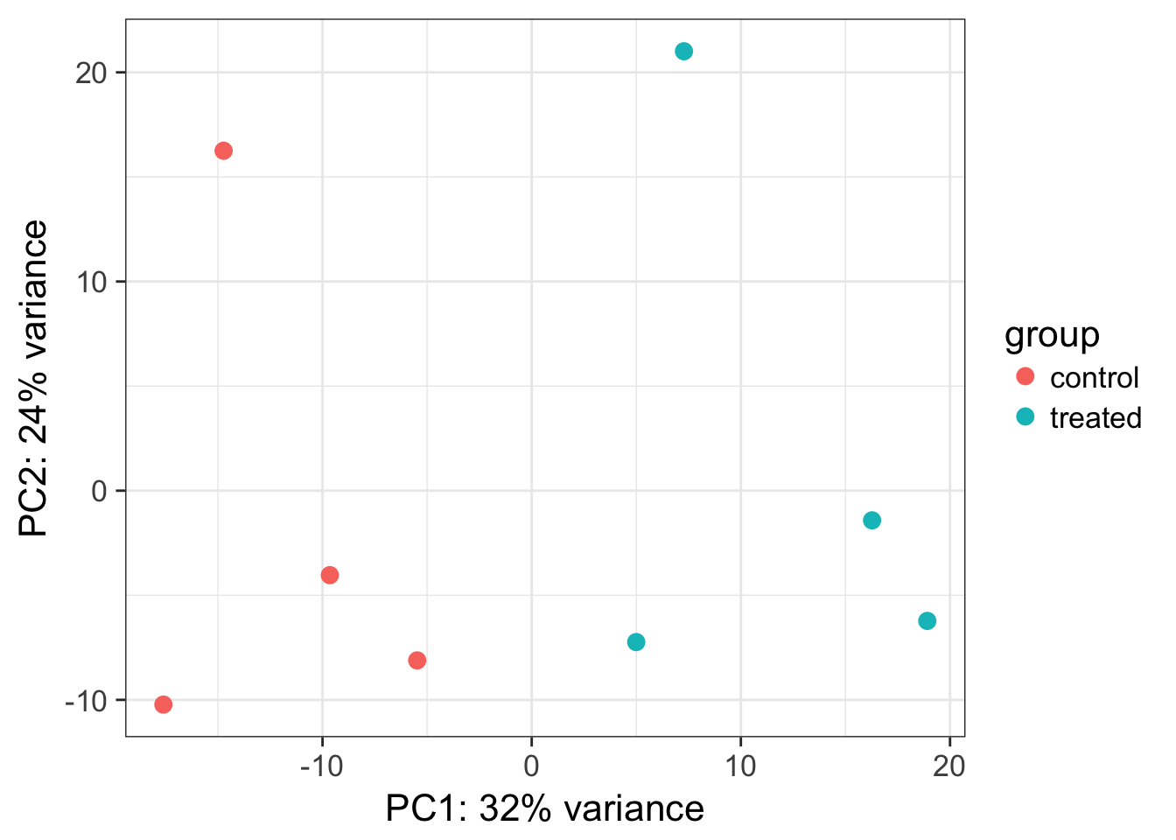
RNA-seq Downstream Analysis
https://bioconnector.github.io/workshops/r-rnaseq-airway.html

Slide 25
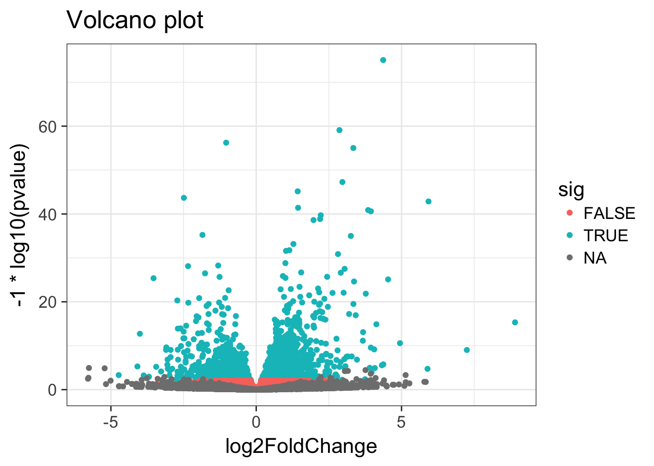
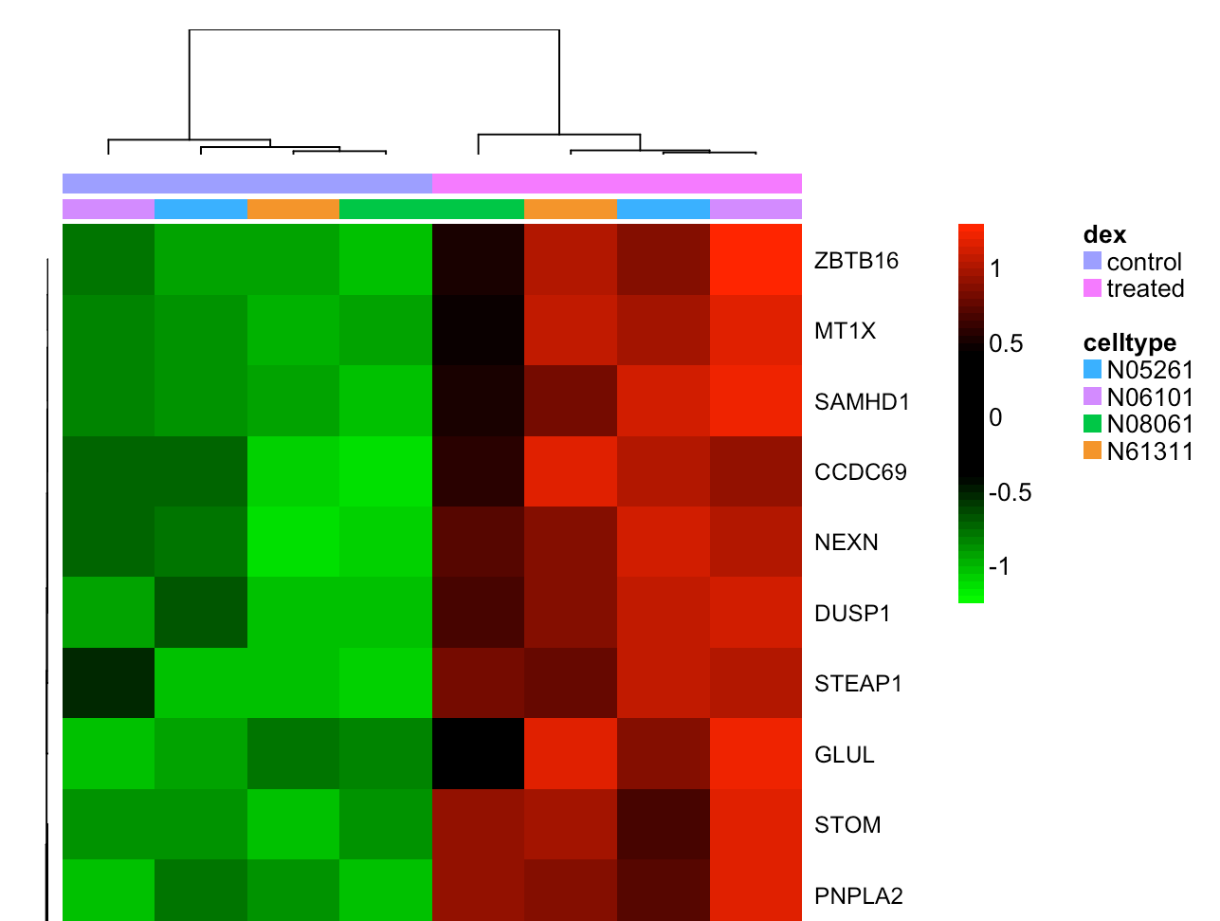
RNA-seq Downstream Analysis
https://bioconnector.github.io/workshops/r-rnaseq-airway.html

Slide 26
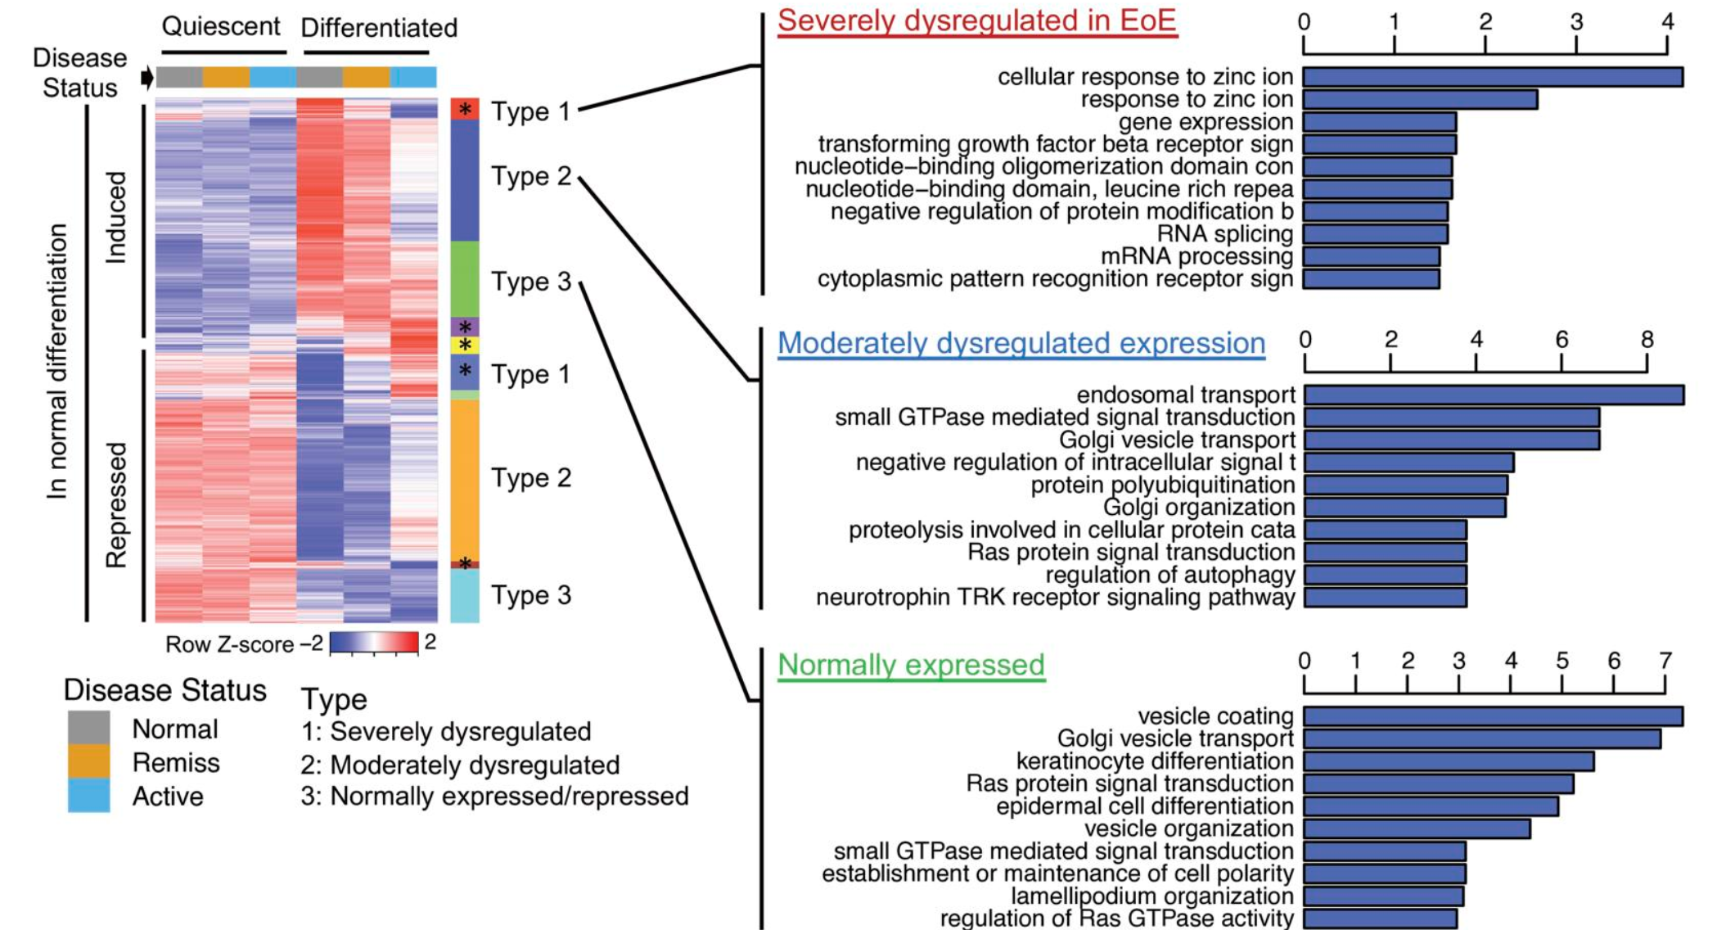
RNA-seq Downstream Analysis
https://insight.jci.org/articles/view/159093/figure/5

Slide 27
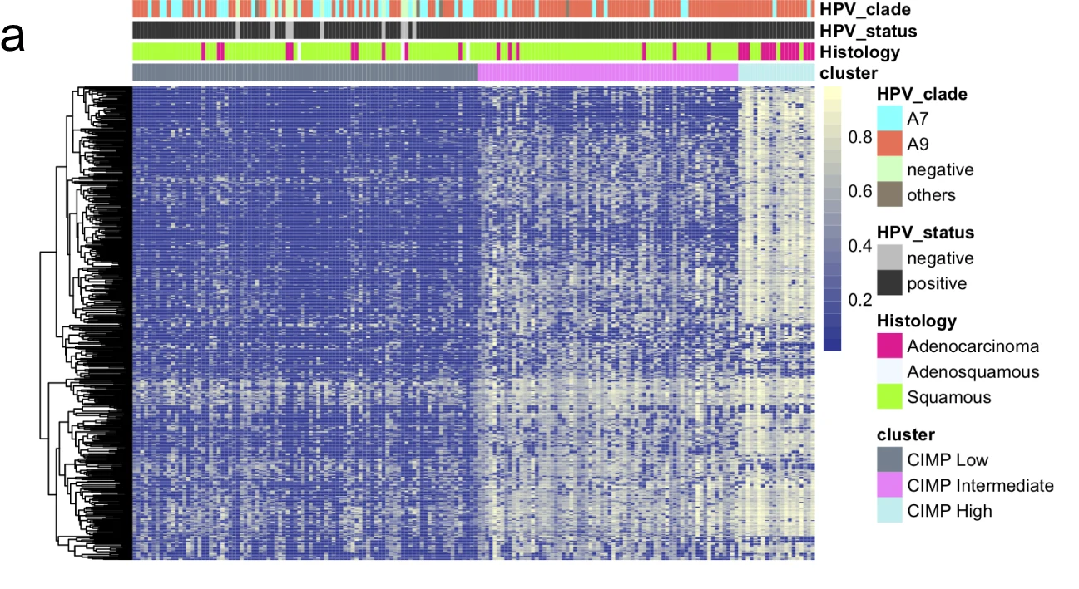
BioMedical data: DNA methylation (p >> n)
n = number of samples 6, 10, 100, 1k
P = number of CpG 28M
https://www.nature.com/articles/s41392-019-0081-6/figures/1

Slide 28
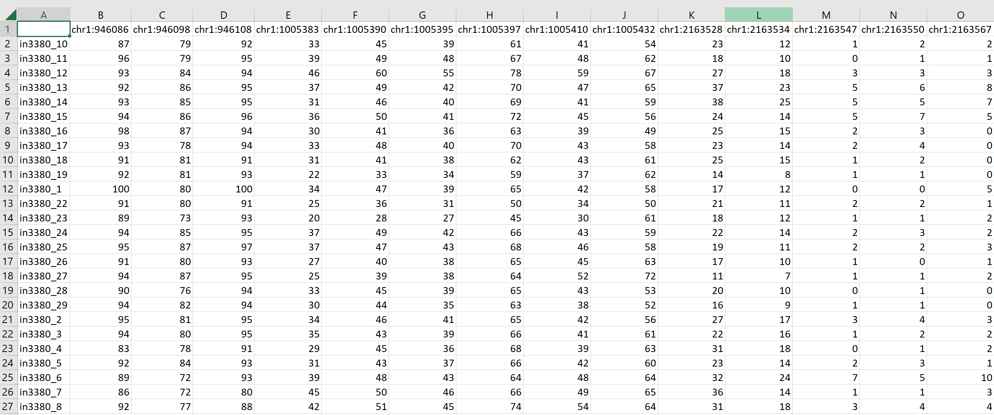
BioMedical data: DNA methylation (p >> n)
Columns chr___: 1254 CpG sites
Columns y:
0: normal sample,
1: insignificant tumor,
2: significant tumor
Rows: 334 samples

Slide 29
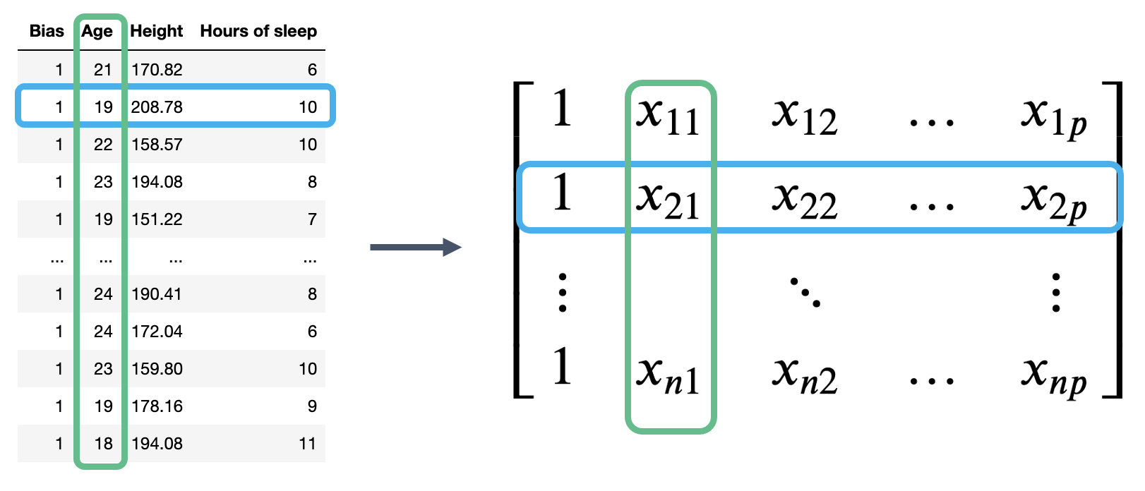
What is feature/variable selection?
Find the features (variables/columns) in X which are important for predicting, and remove the features that are not
Give:
Find the columns in X which are important for predicting y
https://ds100.org/course-notes/ols/ols.html
https://ubc-cs.github.io/cpsc330-2023W1/lectures/13_feature-engineering-selection.html

Slide 30
Why feature selection?
Interpretability: Models are more interpretable with fewer features.
If you get the same performance with 10 features instead of 500 features, why not use the model with smaller number of features?
Computation: Models fit/predict faster with fewer columns.
Data collection: What type of new data should I collect? It may be cheaper to collect fewer columns.
Fundamental tradeoff: Can I reduce overfitting by removing useless features?
Feature selection can often result in better performing (less overfit), easier to understand, and faster model.
https://ubc-cs.github.io/cpsc330-2023W1/lectures/13_feature-engineering-selection.html

Slide 31
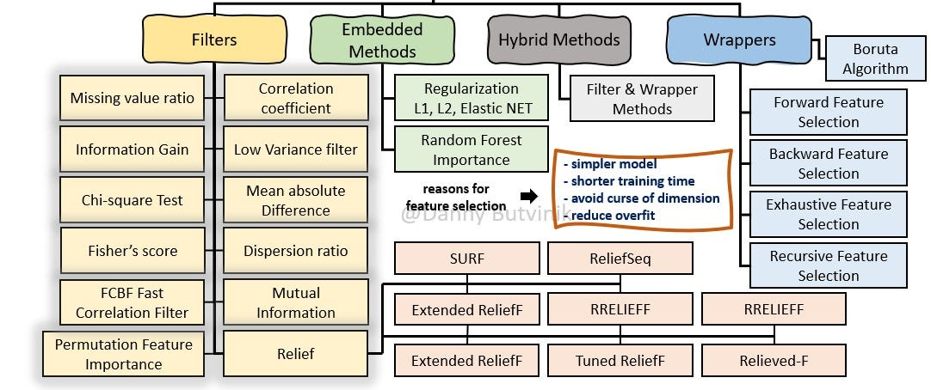
How do we carry out feature selection? Supervised Feature Selection
https://medium.com/analytics-vidhya/feature-selection-extended-overview-b58f1d524c1c

Slide 32
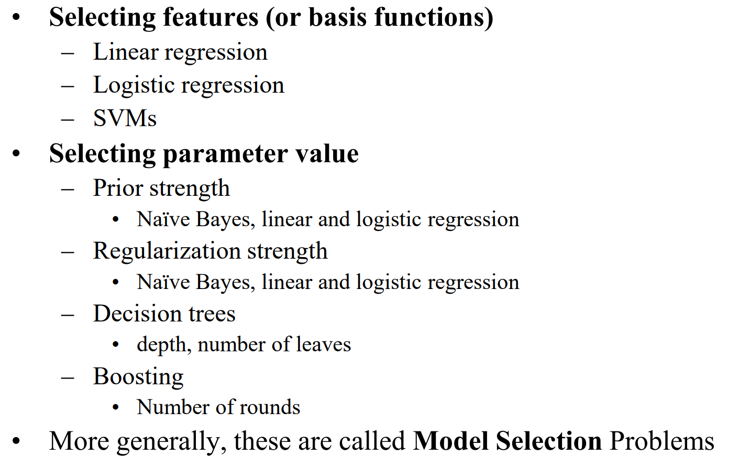
Model Selection vs Feature Selection
Feature Selection is a part of Model Selection
https://www.cs.cmu.edu/afs/cs/academic/class/10601-f10/lecture/lec16.pdf

Slide 33
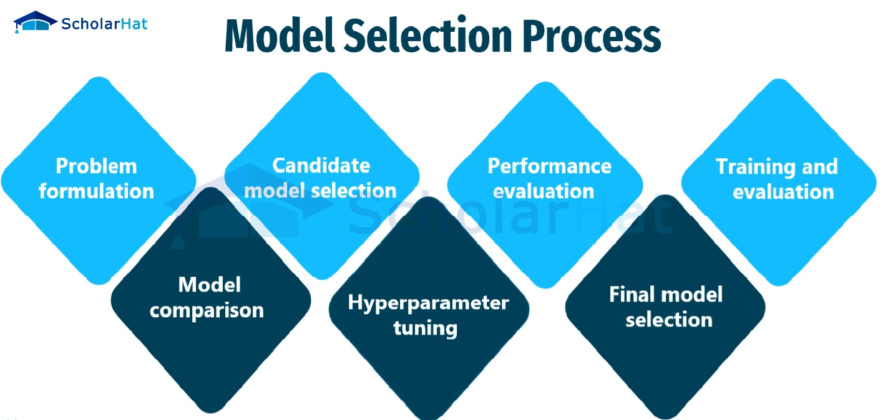
Model selection: steps
https://www.scholarhat.com/tutorial/machinelearning/model-selection-for-machine-learning

Slide 34
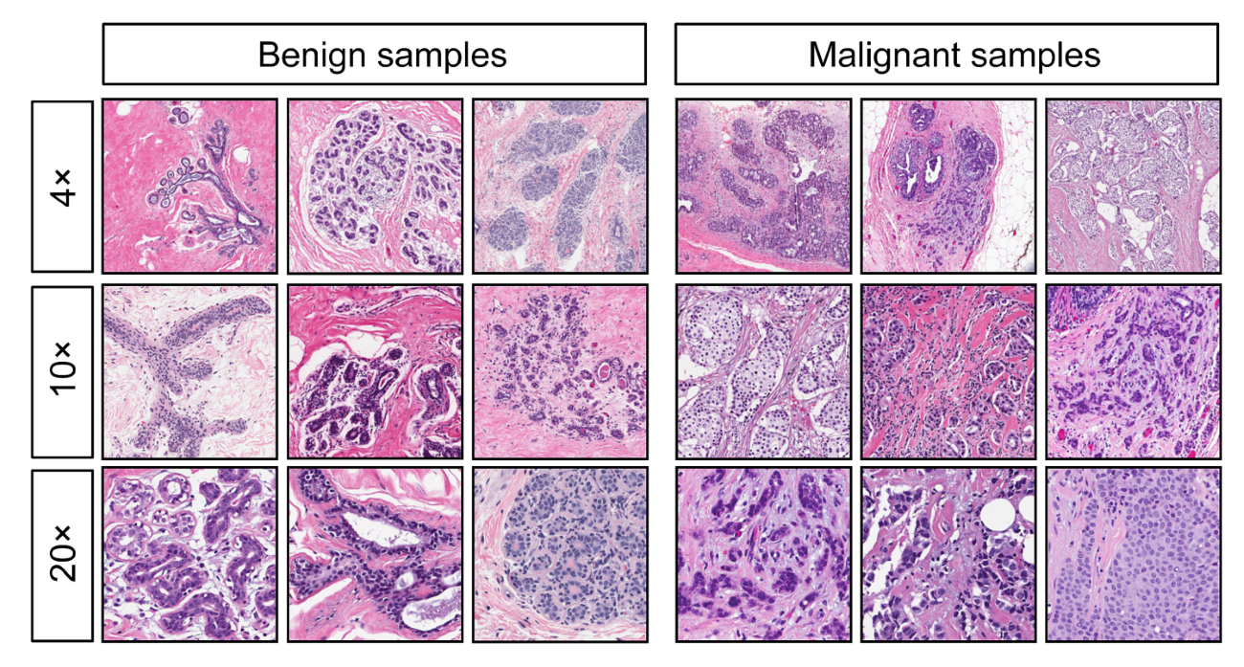
Model selection: steps
Stage 1: Selecting the regression model forms
Stage 2: Selecting the regression model and the independent variables
Stage 3: Fitting the model
Stage 4: Examining or validation of the applied model
https://www.shiksha.com/online-courses/articles/model-selection-in-machine-learning-regression/
https://medium.com/analytics-vidhya/breast-cancer-diagnostic-dataset-eda-fa0de80f15bd

Slide 35
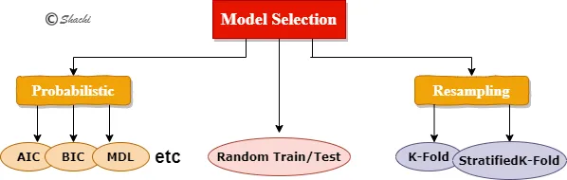
Model selection: methods
https://medium.com/analytics-vidhya/model-selection-techniques-in-ml-ai-with-python-fdf308d9fa10

Slide 36
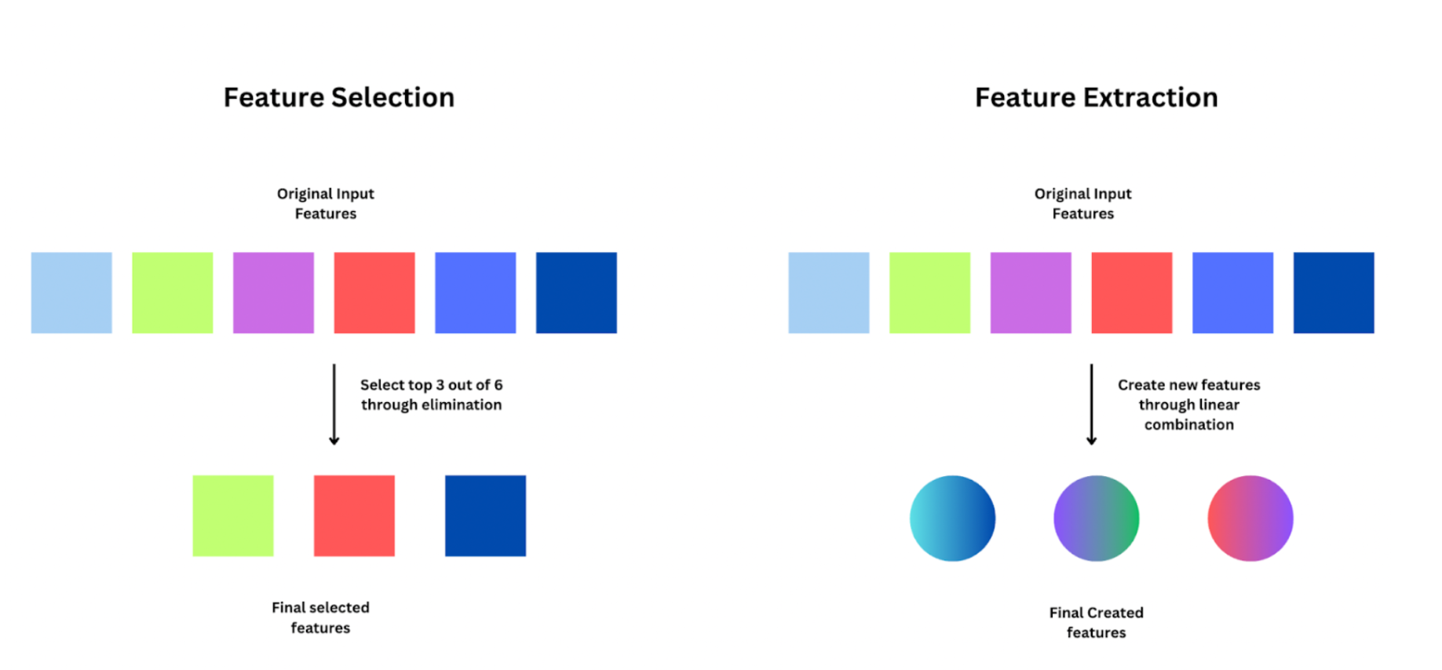
Feature Selection vs Feature Extraction/Engineering
https://viso.ai/deep-learning/feature-extraction-in-python/

Slide 37
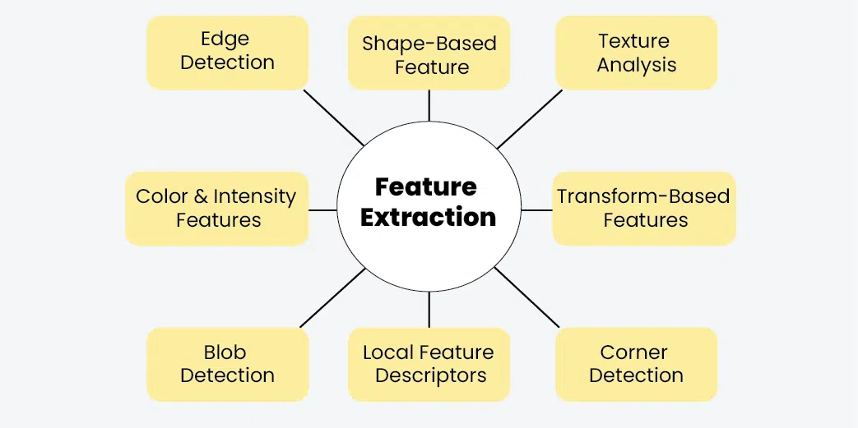
Feature Extraction/Engineering
https://www.geeksforgeeks.org/feature-extraction-in-image-processing-techniques-and-applications/

Slide 38
How do we carry out feature selection? Supervised Feature Selection
https://medium.com/analytics-vidhya/feature-selection-extended-overview-b58f1d524c1c

Slide 39
Xin chân thành cảm ơn!
Luu Phuc Loi, PhD
Zalo: 0901802182
luu.p.loi@googlemail.com

